Slide 1

Zomato
Global Restaurant
Analysis & Insights

Slide 2

About Zomato
Zomato is an Indian multinational restaurant aggregator and food delivery company. It was founded by Deepinder Goyal and Pankaj Chaddah in 2008. Zomato provides information, menus and user-reviews of restaurants as well as food delivery options from partner restaurants in more than 1,000 Indian cities and towns. Zomato is an online restaurant discovery guide providing information on home delivery, dining-out, cafés and nightlife. Zomato Limited was originally incorporated as a Private Limited Company with the name DC Foodiebay Online Services Private Limited
Launched in 2010, Zomato’s technology platform connects customers, restaurant partners and delivery partners, serving their multiple needs. Customers use the platform to search and discover restaurants, read and write customer generated reviews and view and upload photos, order food delivery, book a table and make payments while dining-out at restaurants. On the other hand, It provide restaurant partners with industry-specific marketing tools which enable them to engage and acquire customers to grow their business while also providing a reliable and efficient last mile delivery service. Zomato also operate a one-stop procurement solution, Hyperpure, which supplies high quality ingredients and kitchen products to restaurant partners and also provide their delivery partners with transparent and flexible earning opportunities.

Slide 3
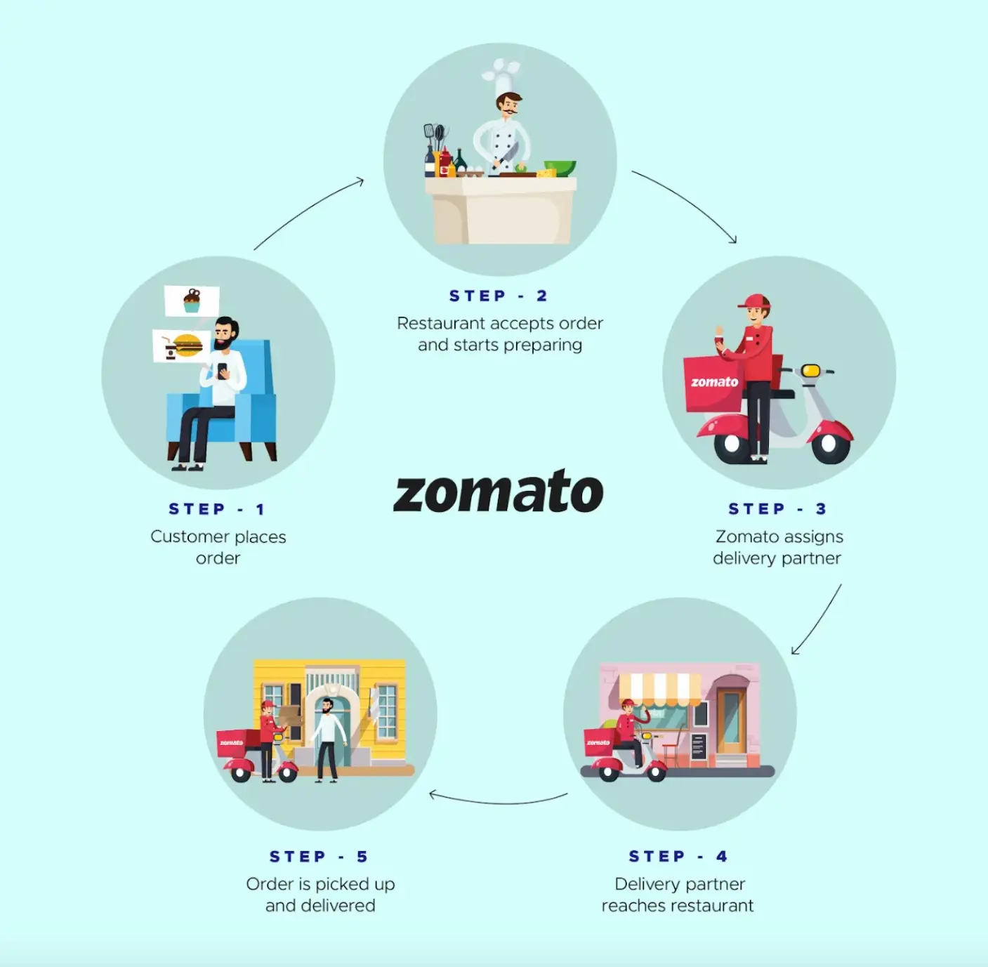
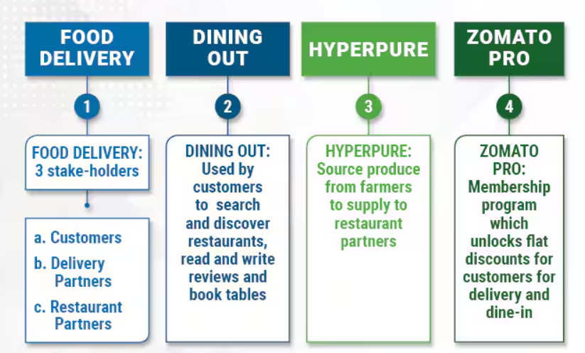
How Zomato Works Zomato is not just a Food delivery app, It works various field in food industry

Slide 4
Problem Statement
Despite Zomato's vast user base and global presence, there exists a significant gap in the market for high-quality, Zomato-branded restaurants that offer a consistent and exceptional dining experience across different countries. Current challenges include :
Inconsistent dining experiences across locations.
Limited brand visibility and recognition in new markets.
Difficulty in maintaining quality control and standards across multiple locations.
Inefficient use of Zomato's vast user data and insights for restaurant development

Slide 5

Objective
Zomato is a large company which works in Food and Beverage business. There is huge amount of data that it generates through its website and application. We are given a some of that data and our objective is ta analyse that given data and bring out some Insights for the growth of company.
The data is given in table form which contains various information like number of restaurants , countries and cities where they are located, opening date cuisines, rating, price range etc.
Our objective is to clean data, handle missing values and then present the data in simple and readable form which will be easy for understanding ani getting Insights.

Slide 6
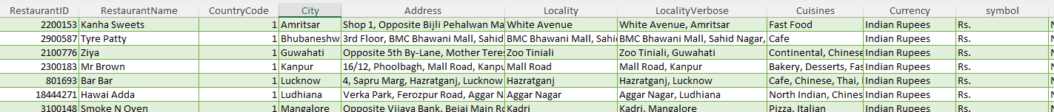
Overview on Zomato Dataset
Data overview
There is total of 9551 restaurants present in data.
The restaurants are located in 15 countries and 141 cities.
There are 1824 types of cuisine options including breakfast, lunch, dinner and dessert .
The data contains the date of opening of the restaurant is located in each country.
Information like Rating, Price range, votes, provided with data. The average cost two is also given for reference to pull out insights.
The information like does the restaurant provide online delivery, does it have table booking is also provided which is beneficial for getting insights.

Slide 7

Data Cleaning
The column like Latitude and Longitude which were having lots of blank values was deleted.
Blank space in cuisine column was filled corresponding to its Country code with most popular cuisines .
Customised column was created for price for two with its currency symbol.
New column was created to extract country name using given country code.
Year of opening was separated in separate column.
Price for two was converted in Indian currency and stored in separate column.
The rating was simplified and categorized in 4 parts for further use.

Slide 8



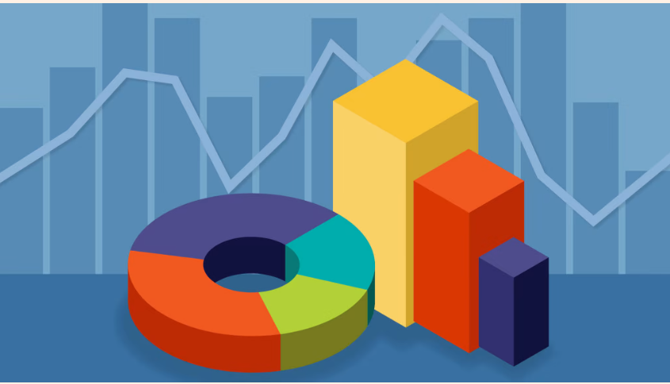
Methodology
Analytical Approach and Tools
Data Cleaning: Unwanted columns were deleted for making data clean. Find and replace was used to replace blanks from cuisine column.
Data Enrichment: Enticed the dataset with additional variables using VLOOKUP to cross- reference.
Descriptive Analysis: Employed PivotTables for summarizing key metrics and distinguishing data according to its Country, Rating, Year of opening, O of restaurants etc.
Handling missing data: Missing data from cuisine column was cleared using Find and Replace function.
Visualization: Created dashboard with dynamic charts and slicers for data representation, understanding and enabling interactive data exploration

Slide 9
Objective Analysis of Data
The Raw data has a tables which detail information of all the necessary data which was needed for analysis. The data needed to be cleaned and sorted so that could be utilised effectively that was done by various functions like Lookups, Sort & Filters, Find & Replace, Conditional formatting etc.
Some new column were created for simplification purpose And were also told to do so. Some data was also deleted which was not needed or was not useful for the point of analysis it simplify the data.
The column having the blank space were filled with respect to the country they are using Sort an filter function.
To simplify the data various Logical functions, Aggregation functions and Conditional aggregation were used for getting the outcomes which can be used which essential for further analysis of data which made data simpler to understand an to work on it.
Pivot charts were created to simplify the data for better visualization and understanding.

Slide 10
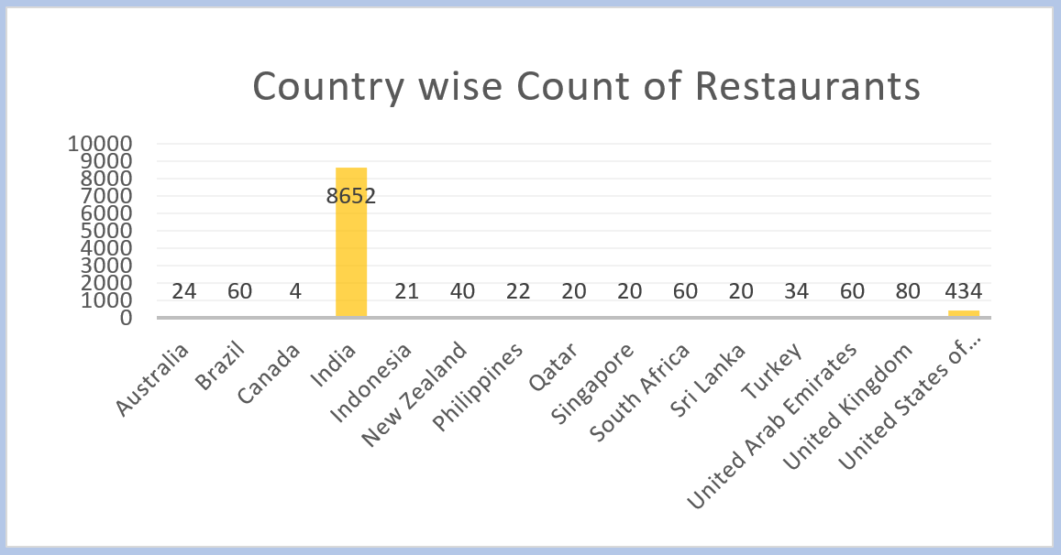
Data Analysis
Number of Restaurants in each country
The given chart displays the country wise count of restaurants present in given data. This column chart gives the count of restaurant with comparison other countries
India is the country with highest number of restaurant with 8652 restaurant present in the country
Canada is the country with least number of restaurants with count of 4 restaurants

Slide 11
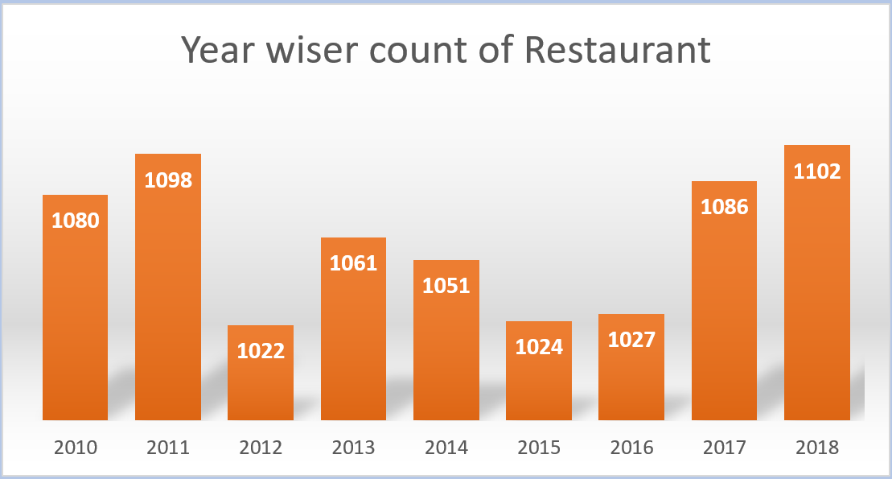
Restaurant opened each year
The given chart gives you the year wise count of restaurants opened.
The most number of restaurants were opened in 2018 which was 1102, followed by year 2011 which was 1098
The least number of restaurants were opened in year 2012 which was 1022

Slide 12
Charts Displaying the percentage of restaurants Providing online delivery
Restaurant providing Table booking
The above chart shows the percentage of restaurant provide Table booking in all the countries from the given data

Slide 13
Charts Displaying the percentage of restaurants Providing online delivery
Restaurants providing online Delivery
The above chart shows the percentage of restaurant provide Online Delivery in all the countries from the data.

Slide 14
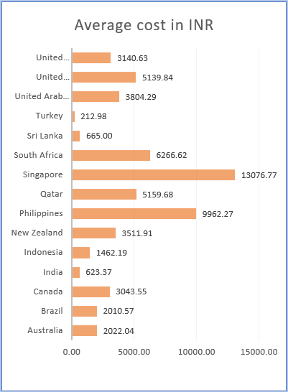
Average cost of Two in INR
The chart shows the Average cost of two person in Indian Rupees for all countries present in the data
The data contains the price for two persons in the currency with respect to that specific country. For easy understanding and evaluation the currency was converted in Indian rupees by taking the conversion price of each respective country.
Singapore is the country having highest cost for two in Indian currency i.e., 13076.77
Turkey is having lowest cost for two with just 212.98 rs.

Slide 15
Average Price Range in Each Country
The given chart gives you the average Price Range of given countries
The term "average price" generally refers to the mean price of a particular item or service over a specific period or across a range of transactions. It’s calculated by adding all the prices together and dividing by the number of prices. This metric helps to understand typical market values.

Slide 16
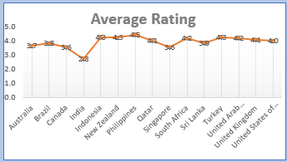
Average Rating in Each Country
The average rating of a restaurant is typically calculated by taking the total of all individual ratings given by customers and dividing it by the number of ratings received.
This average helps consumers gauge the overall quality and customer satisfaction of the restaurant compared to others. Different countries and cultures may have variations in how these ratings are interpreted and valued.

Slide 17
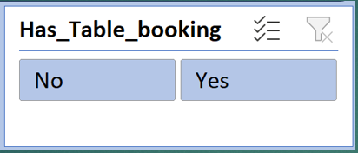
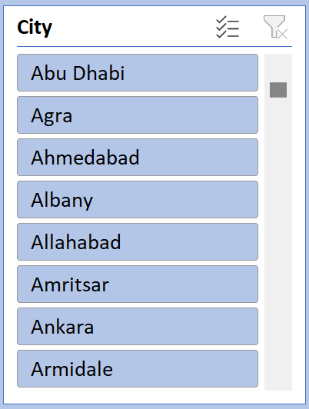
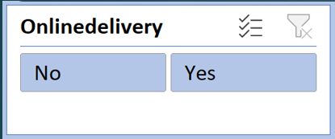
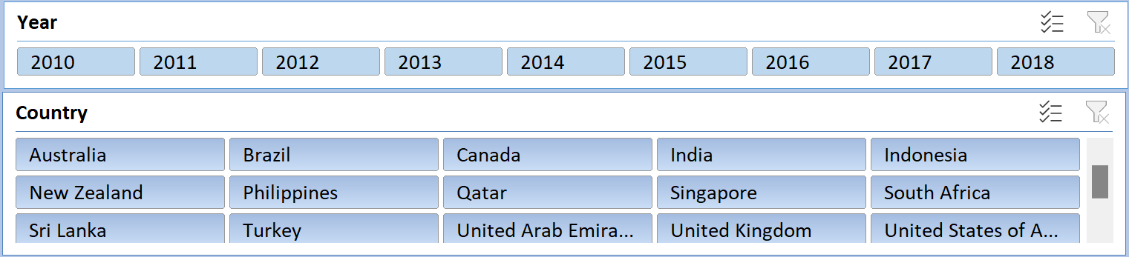
Slicers
This slicer are used to filter the data according to use
This slicer is used to filter the data on the basic of table booking
This slicer is used to filter the data on the basic of City
This slicer is used to filter the data on the basic of Online Booking
This slicer is used to filter the data on the basic of Year and Country

Slide 18

Suggestions and Insights
The given data was Cleaned and Enriched and brought to readable and understandable form for getting Insights and suggestions.
After visualizing the data I suggest that the company should open the restaurants in
New Zealand,
Philippines
Turkey.
The reason behind my suggestion is that
This countries has less number of restaurants present currently.
Growth in number of restaurants is seen in past years.
This cities has variety of cuisine in all price range.
The rating is also good for the restaurants.
Price range for cuisine is also evaluated for this purpose.
There is no online delivery service available in this country.
Table booking service is provided in only one country.
Cost of two is also decent with respect to each country

Slide 19
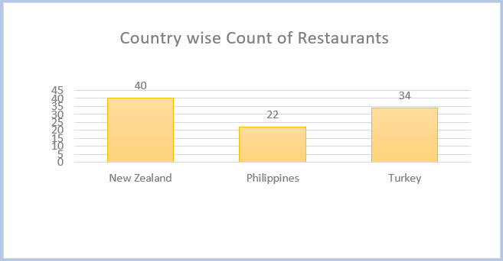
Some Visuals behind Suggestions
Count of Restaurants in Selected Countries
The given chart shows you the exact number of restaurant present in the suggested countries. This helps to decide to countries which should be considered to open new restaurant.

Slide 20
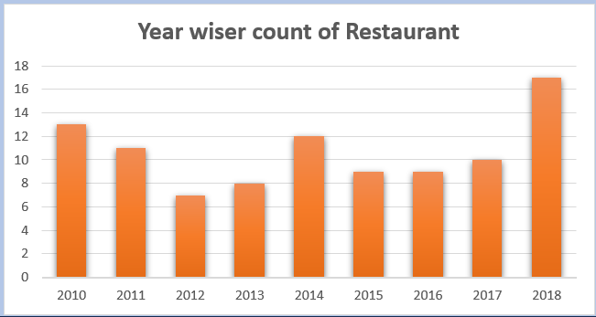
Year wise Count of Restaurants in Selected Countries
The given Chart shows the year wise count of restaurant in the countries I selected as a suggestion to open the restaurant. The chart displayed gives combined count of restaurant in all selected countries.

Slide 21
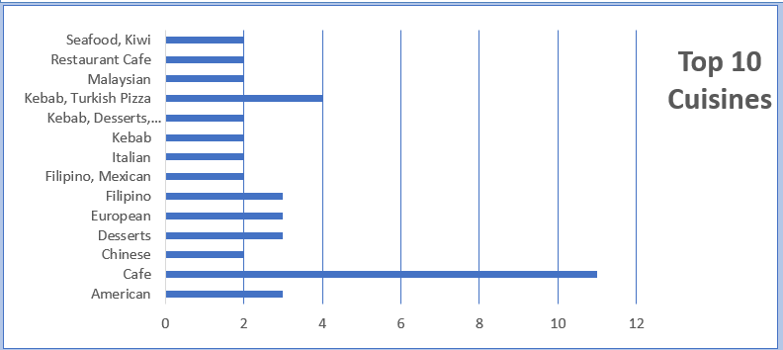
Top 10 Cuisines in Selected Countries
Top 10 Cuisines
This chart displays top 10 cuisine in the selected city with the number of restaurant which Serve that cuisine

Slide 22
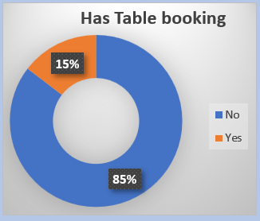
Chart of restaurant having Table booking
Has Table booking
This table shows the percent of restaurants providing Table booking Service

Slide 23
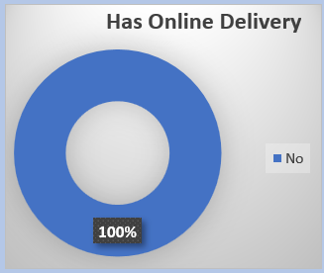
Chart of Restaurant having Online Delivery
Has Online Delivery
This chart provide the percent of restaurants providing Online Delivery Services

Slide 24
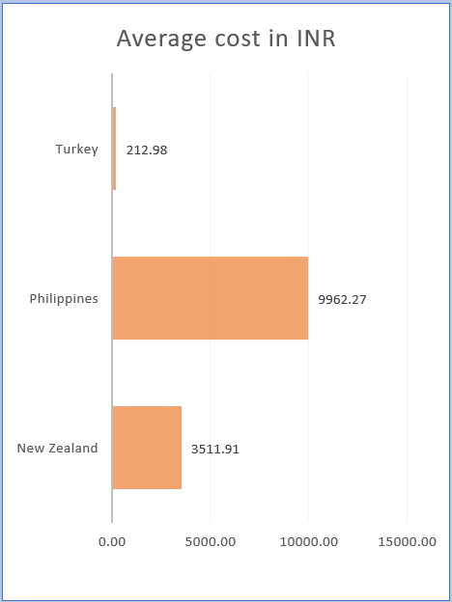
Average cost for 2 in Indian Currency
Average Cost For Two in INR
The above chart shows the average cost for two peoples in Indian Rupees for the Suggested countries

Slide 25
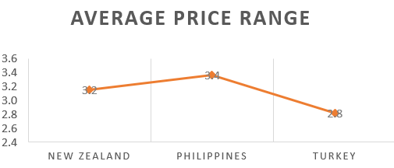
Chart displaying Average Price range
Average Price Range
The above Chart shows Average Price Range for the Suggested Countries

Slide 26
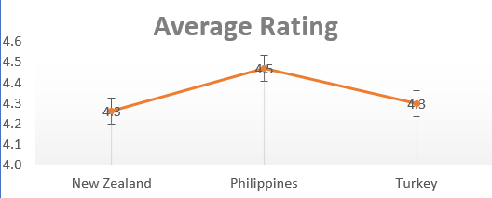
Chart displaying Average Rating
Average Rating
The above Chart shows the Average Rating for the Restaurants in the Countries

Slide 27

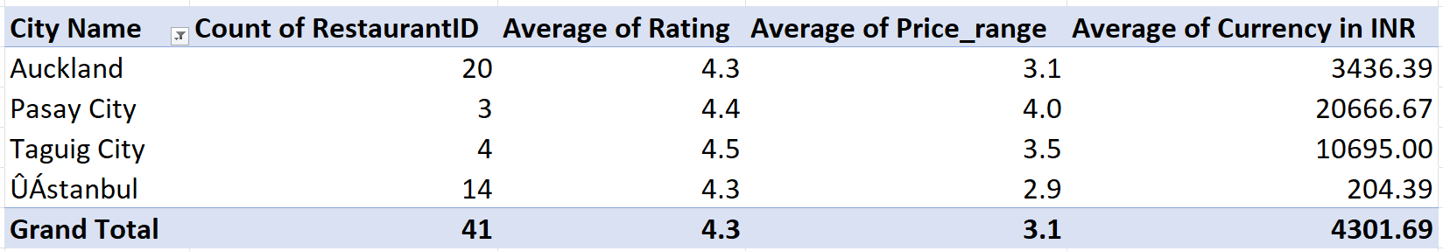
Suggestion on Cities to open Restaurants
After selection of Countries the selection of cities was done. There were few parameters taken under consideration for selection of cities that are as follow
Less number of Restaurants present in that city.
Growth in number of restaurants in last few years.
There is good rating for the existing restaurants.
Price range is between 2 to 5
Wide range of cuisine compared to other cities in that country.
Table booking is not provided in this cities.

Slide 28
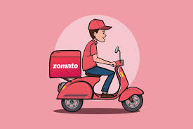
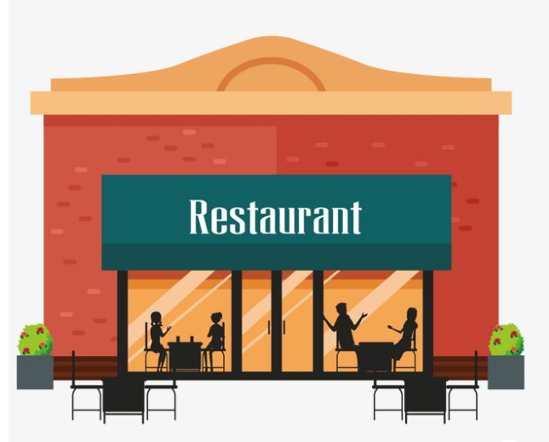
Analytical approach to open n restaurant in selected Cities/Countries.
My general approach for opening new restaurant will focus on 4 things
1- Cuisine – The cuisine which I will select will be Familiar and Favorable to the Locality where I am planning to open the restaurant.
2- Price range – I will always go with medium and higher price like upper bracket of price range. I will consider the lower price if and only if it has high demand.
3- Competition & High Demand - I will generally prefer the area with low competition and higher demand. Places like Hospitals, School & Colleges and working areas.
4- Service – I will ensure that we provide the best service in that area where we are working

Slide 29
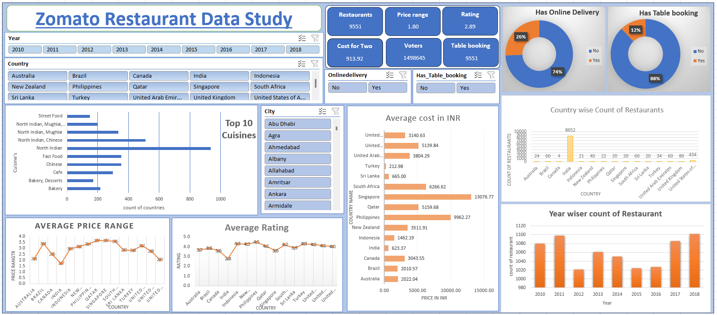
Dashboard

Slide 30
Conclusion
The Conclusion After analyzing the data it is evident that significant opportunities exist for strategic global expansion. The data highlights a robust demand for diverse dining options and a growing appetite for innovative restaurant concepts across various regions. By capitalizing on these insights, restaurant chains can strategically position themselves in emerging markets, tailor their offerings to local preferences, and take advantage of the expanding global food service industry. This approach not only promises to enhance brand presence but also to drive substantial growth in new international markets.

Slide 31


